Slide 1
CPS 2.2 Features
Internal Use - Confidential

Slide 2
Show Technical Support
“show tech-support” command collects all the information that are required to debug the switch in case of any issues.
User can invoke “Show Tech Support” to fetch for selected devices using following options in UI.
  Jobs ➔ <Scheduled Jobs> Tab ➔ Add (Switch Show TechSupport)
User can invoke a job to fetch Show Technical Support data for selected switches

Slide 3
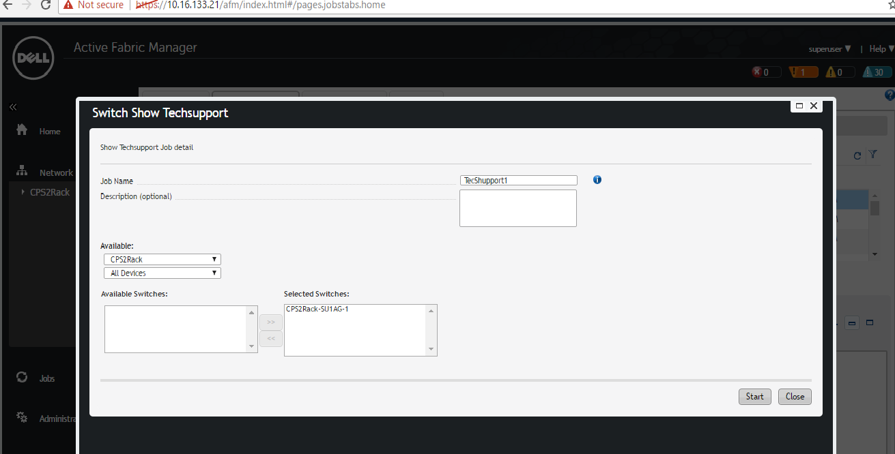
Show Tech support Job Screen

Slide 4
Once User clicks Start button, Job will be triggered to fetch “Show Tech Support” for the selected switches
Once Job is completed, it will be listed out in Job Results Section

Slide 5
Show Tech Support Downloads Page
User can download the “Tech Support downloads” zip file from Maintenance -> “Show Techsupport Downloads” section of a specific fabric. It lists out Tech Support downloads for the specific fabric
User can download the zip file by clicking “click here to download” on the specific Job. (Refer the screenshot in next slide)

Slide 6
Show Tech Support Downloads Page

Slide 7
Authentication between BGP peers
Border Gateway Protocol (BGP) routing peers can be configured with Message Digest 5 (MD5) algorithm which is used to support routing authentication
BGP authentication can be very useful to make difficult for an authorized or malicious user to disrupt your network routing tables
BGP authentication can be enabled by placing following CLI in bgp configuration
  neighbor {ip-address | peer-group-name} password 7 <encrypted password>

Slide 8
BGP authentication password input
BGP Authentication password can be entered in Predeployment page -> BGP Password Authentication wizard
BGP neighbor authentication can be optionally enabled

Slide 9
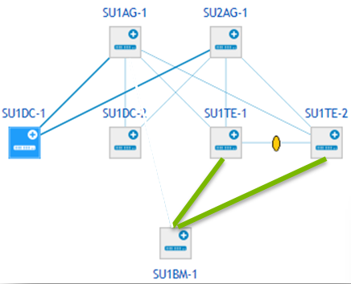
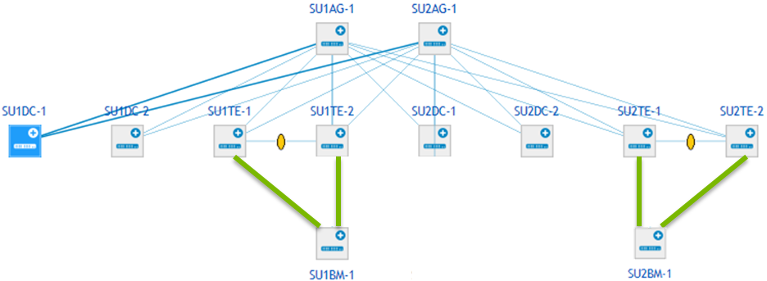
BMC re-wiring
MSFT introduced a modification of the 2016 topology to provide HA for BMC paths. With this change, the BMC switch is connected to each pair of tenant switches instead of a single link to the top aggregation switch (eg., SU1BM-1 to SU1TE-1 and SU1TE-2)
The decision was not to support this topology on AFM. However, AFM will suppress wiring validation errors from BMC switch to the next hop

Slide 10
Suppression of BMC wiring validation
BMC re-wiring is not introduced into AFM CPS. Instead, it continues to use and deploy the existing 2016 topology.
This wiring change could lead to wiring errors (Wiring Error or Wiring mismatch) by the AFM CPS.
In order to avoid AFM reporting wiring errors, wiring validations are suppressed for the following ports for all 2016 topologies
From Device | From Port | To Device | To Port | Link Type | Type
SU1AG-1 | 1/7 | SU1BM-1 | 1/52 | Fabric Link | One Rack
SU1AG-1 | 1/7 | SU1BM-1 | 1/52 | Fabric Link | Two Rack
SU2AG-1 | 1/7 | SU2BM-1 | 1/52 | Fabric Link | Two Rack

Slide 11
TACACS Configuration (AFM CPS)
AFM supports external TACACS server
Authentication type can be set in Initial or Admin Wizard
AFM supports following 4 options
  Local authentication
  TACACS+ authentication
  Local followed by TACACS+
  TACACS+ followed by Local

Slide 12
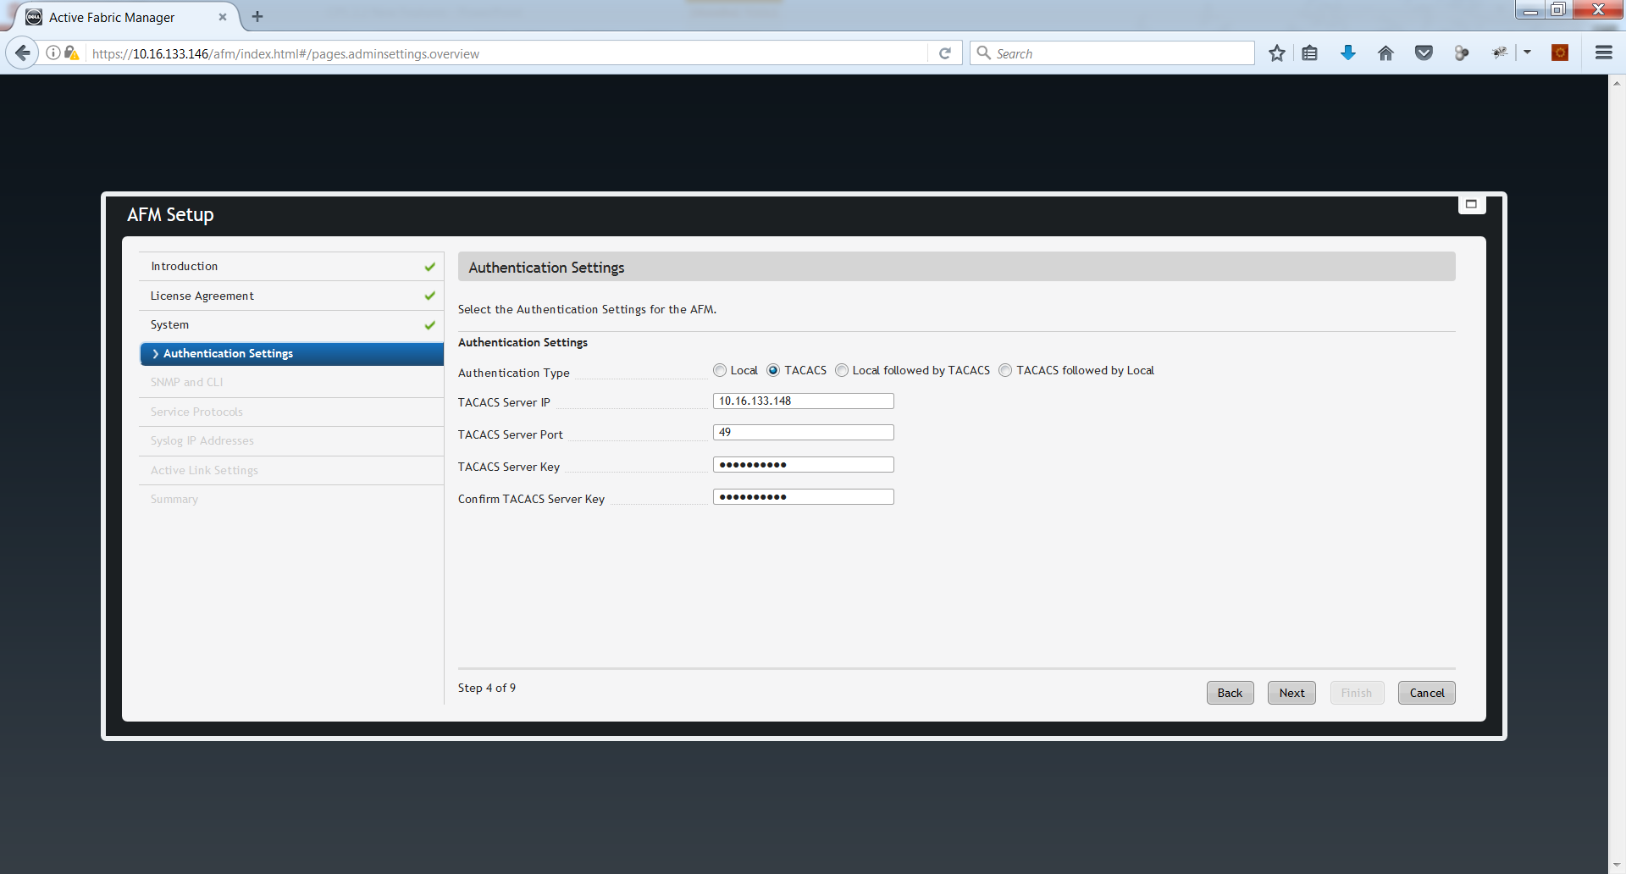
Initial Wizard Settings (AFM)

Slide 13
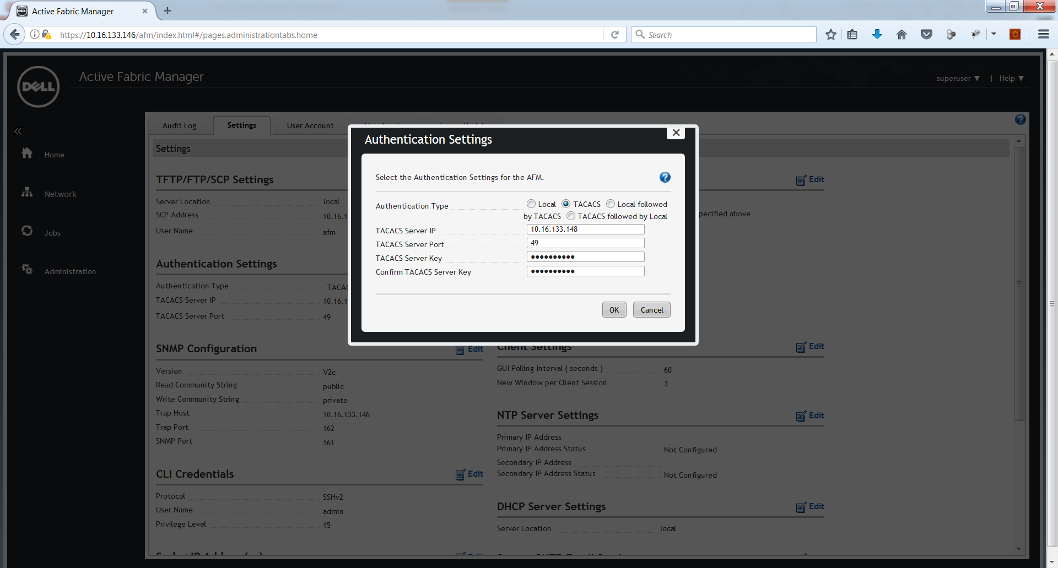
Admin Settings (AFM)

Slide 14
TACACS Configuration (Switch)
TACACS can be configured in pre-deployment wizard
TACACS authentication can be enabled or disabled in switch
TACACS configurations are pushed to the device during deployment

Slide 15
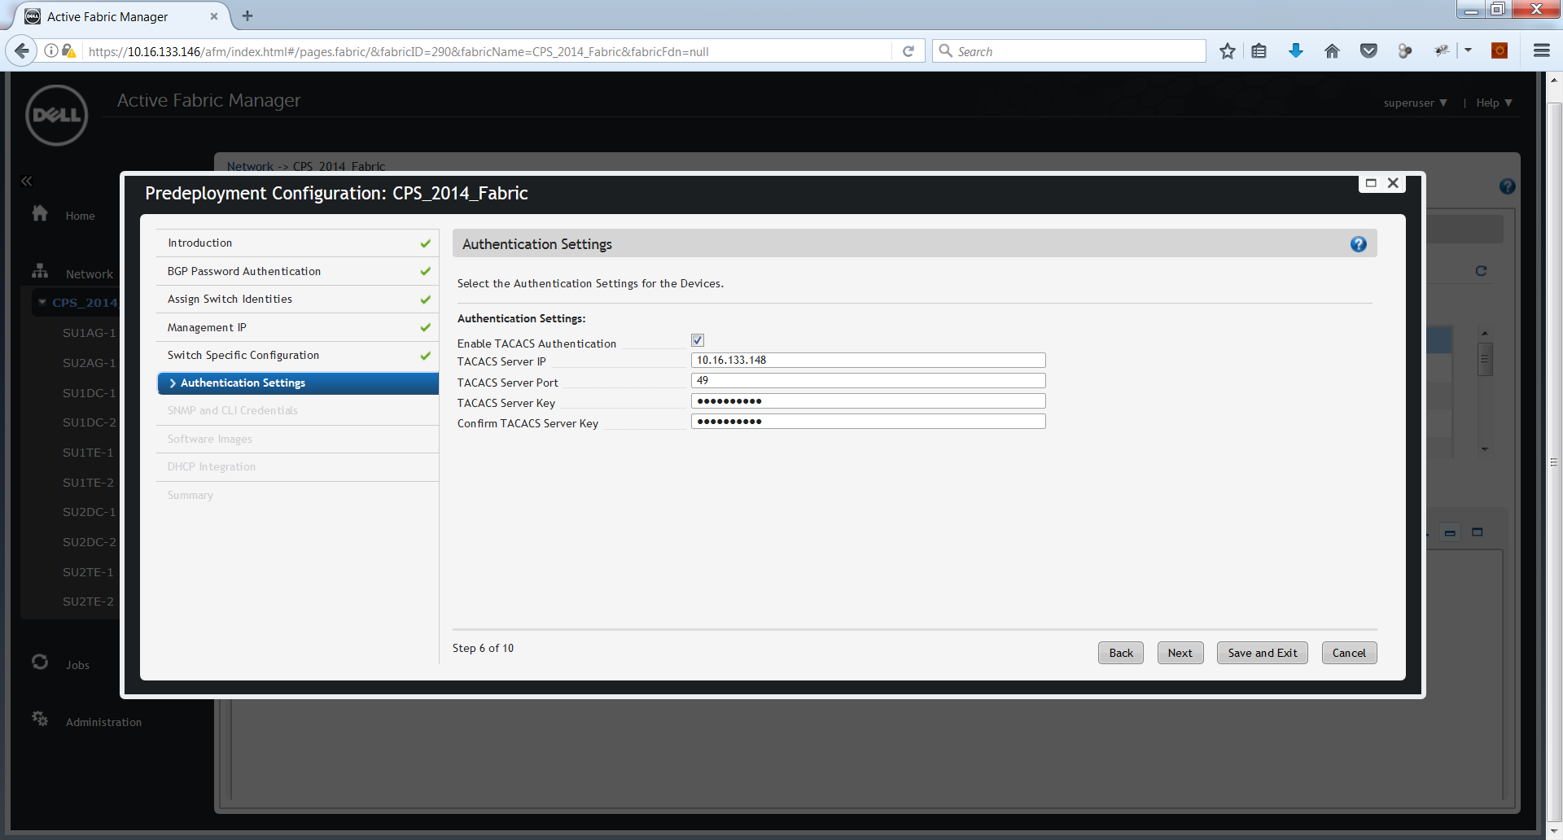
Pre Deployment Settings (Device)

Slide 16
Adding new FTOS Image
Available in all AFM CPS Releases
Using console option New FTOS image can be added to AFM
User has to select “Upload Switch Software Image” to add a new FTOS image.
This console option will take care of placing the new image in the appropriate location like /var/scp or /var/ftp or /var/tftp
As long as the new image is backward compatible no change is required in AFM CPS to support the new image.
By default, it picks the default SmartScript package available for that platform

Slide 17
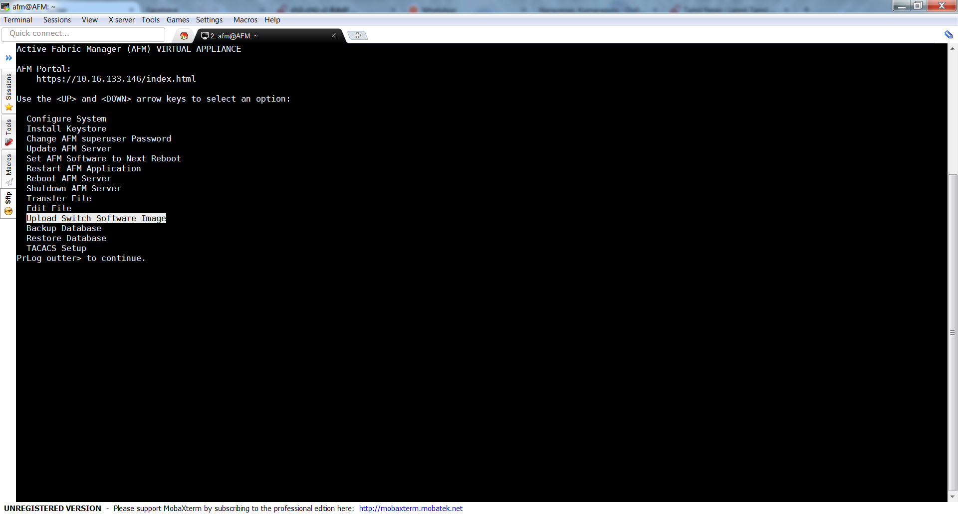
Upload Switch Software Image

